Slide 1
Visible Surface Detection Method Unit 6 (LH 1)

Slide 2
Visible Surface Determination
It is the process of identifying those parts of a scene that are visible from a chosen viewing position.
There are numerous algorithms for efficient identification of visible objects for different types of applications.
These various algorithms are referred to as visible-surface detection methods. Sometimes these methods are also referred to as hidden-surface elimination methods.
•To identify those parts of a scene that are visible from a chosen viewing position (visible-surface detection methods).
•Surfaces which are obscured by other opaque surfaces along the line of sight are invisible to the viewer so can be eliminated (hidden-surface elimination methods

Slide 3
Visible surface detection methods are broadly classified according to whether they deal with objects or with their projected images.
These two approaches are
1. Object-Space methods:
•Compares objects and parts of objects to each other within the scene definition to determine which surface as a whole we should label as visible.
•Deal with object definition
•E.g. Back-face detection method

Slide 4
2. Image-Space methods:
•Visibility is decided point by point at each pixel position on the projection plane.
•Deal with projected image
•E.g. Depth-buffer method, Scan-line method, Area-subdivision method

Slide 5
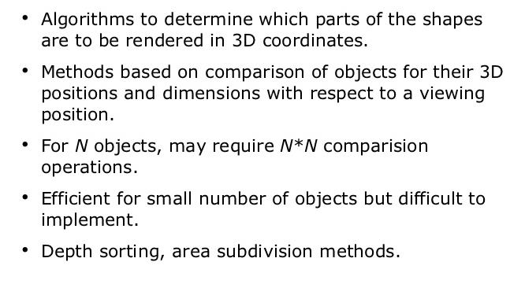
Object-Space methods

Slide 6
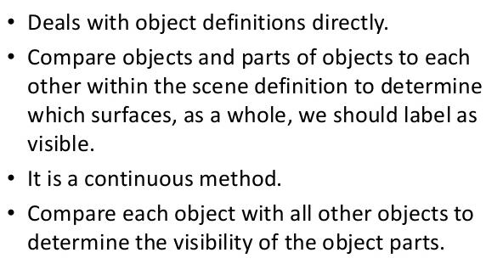

Slide 7
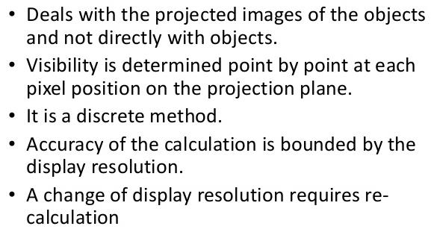
Image Space Methods

Slide 8
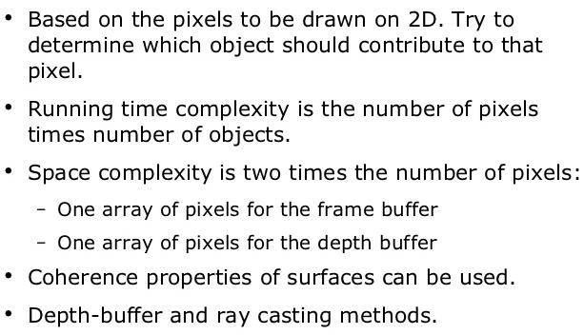

Slide 9
Back Face Detection Methods
•A fast and simple object-space method for identifying the back faces of a polyhedron.
•It is based on the performing inside-outside test.
TWO METHODS:
First Method:
•A point (x, y, z) is "inside" a polygon surface with plane parameters A, B, C, and D if Ax+By+Cz+D < 0 (from plane equation).
•When an inside point is along the line of sight to the surface, the polygon must be a back face.
•In eq. Ax+By+Cz+D=0
if A,B,C remain constant , then varying value of D result in a whole family of parallel plane
if D>0, plane is behind the origin (Away from observer)
if D<0 , plane is in front of origin (toward the observer)

Slide 10
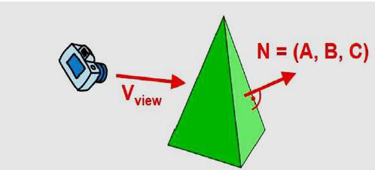
Second Way
•Let N be normal vector to a polygon surface, which has Cartesian components (A, B, C). In general, if V is a vector in the viewing direction from the eye (or "camera") position, then this polygon is a back face
if V.N>0.

Slide 11
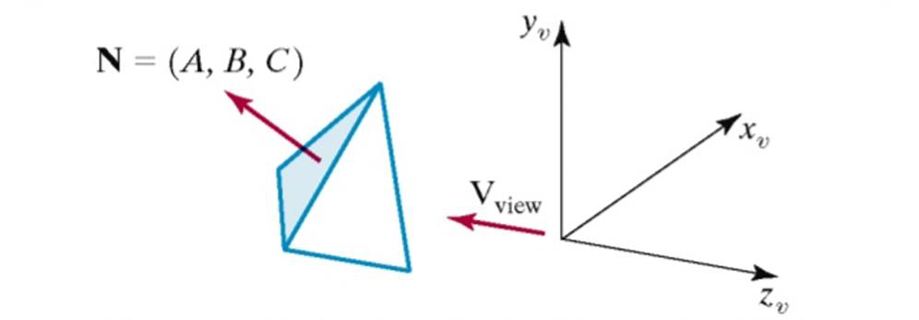

Slide 12
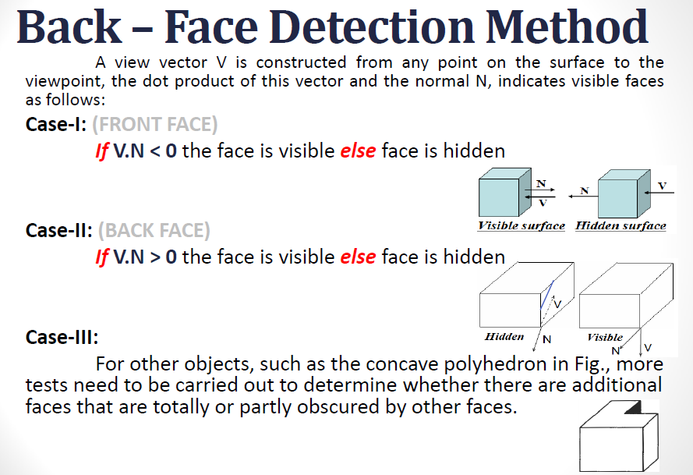

Slide 13
Depth Buffer Method (Z-Buffer Method)
A commonly used image-space approach to detecting visible surfaces is the depth-buffer method, which compares surface depths at each pixel position on the projection plane.
•Also called z-buffer method since depth usually measured along z-axis. This approach compares surface depths at each pixel position on the projection plane.
•Each surface of a scene is processed separately, one point at a time across the surface. And each (x, y, z) position on a polygon surface corresponds to the projection point (x, y) on the view plane.

Slide 14
This method requires two buffers:
•A z-buffer or depth buffer: Stores depth values for each pixel position (x, y).
•Frame buffer (Refresh buffer): Stores the surface-intensity values or color values for each pixel position.
•As surfaces are processed, the image buffer is used to store the color values of each pixel position and the z-buffer is used to store the depth values for each (x, y) position.

Slide 15
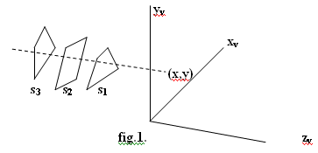

Slide 16
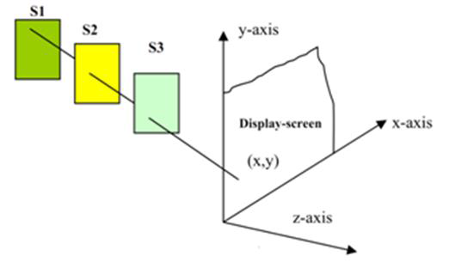

Slide 17
Initially, all positions in the depth buffer are set to 0 (minimum depth), and the refresh buffer is initialized to the background intensity.
Each surface listed in the polygon tables is then processed, one scan line at a time, calculating the depth (z-value) at each (x, y) pixel position.
The calculated depth is compared to the value previously stored in the depth buffer at that position.
If the calculated depth is greater than the value stored in the depth buffer, the new depth value is stored, and the surface intensity at that position is determined and placed in the same xy location in the refresh buffer.
A drawback of the depth-buffer method is that it can only find one visible surface for opaque(solid) surfaces and cannot accumulate intensity values for transparent surfaces.

Slide 18
Algorithm:
1.Initialize both, depth buffer and refresh buffer for all buffer positions (x, y),
depth(x, y) = 0
refresh(x, y) = I background,
(where I background is the value for the background intensity.)
2.Process each polygon surface in a scene one at a time,
2.1. Calculate the depth z for each (x, y) position on the polygon.
2.2. If Z > depth(x, y), then set
depth(x, y)=z
refresh(x, y)= Isurf(x, y),
(where Isurf(x, y) is the intensity value for the surface at pixel position (x, y). )
3.After all pixels and surfaces are compared, draw object using X,Y,Z from depth and intensity refresh buffer.

Slide 19
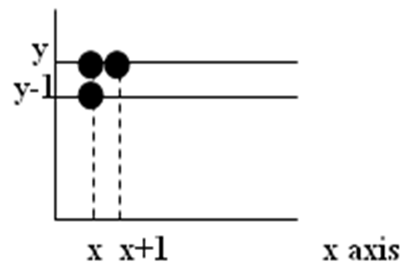
After all surfaces have been processed the depth buffer contains depth values for the visible surfaces and the refresh buffer contains the corresponding intensity values for those surfaces
Depth value for a surface position (x, y) is
z = (-Ax –By – D)/c …………………(i)
Let depth z’ at (x + 1 , y)
z’ = -A(x+1) – By – D/c
or
z’ = z – A/c………..(ii)

